Slide 1




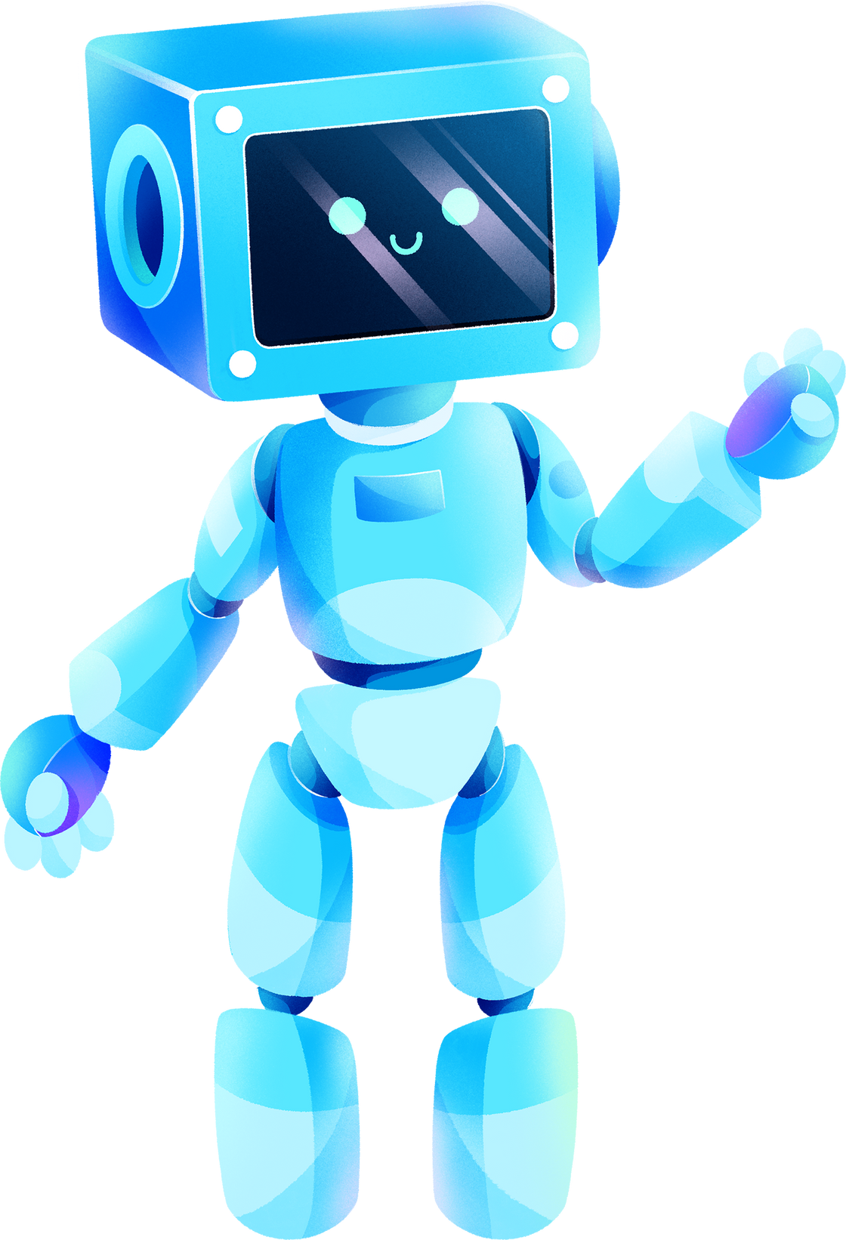

AADI
AI-ASSISTED DESKTOP INTERFACE
By:
Harshada Patil

Slide 2
TABLE OF CONTENTS
Introduction
Project Objectives
Project Scope
Methodology
Technical Architecture
Results and Achievements
Conclusion

Slide 3

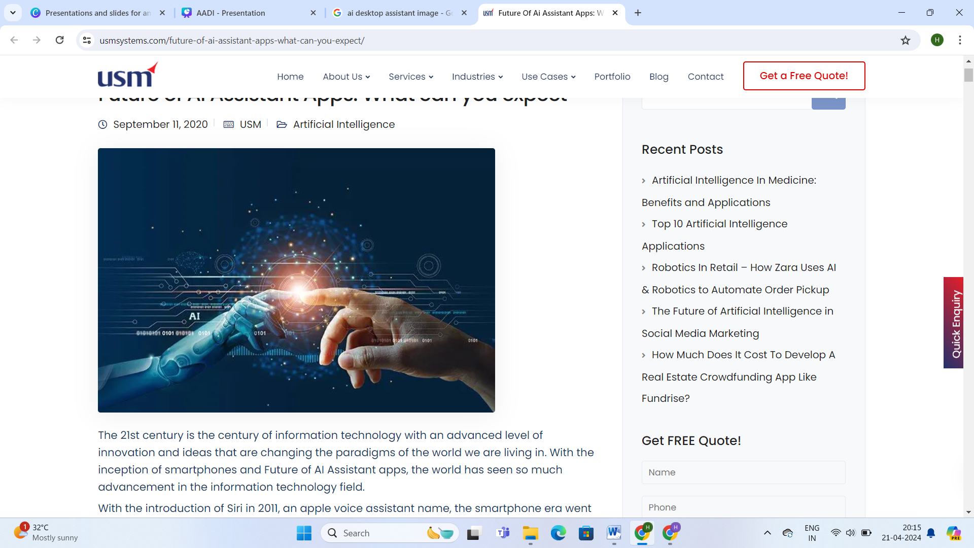
INTRODUCTION
AADI stands for AI-Assisted Desktop Interface.
It is a simple desktop assistant that leverages artificial intelligence to understand user queries and perform tasks efficiently.
AADI serves as a virtual companion, offering seamless assistance in various tasks such as time reporting, internet browsing, system management, entertainment, file management, and more.
With its intuitive interface and intelligent capabilities, AADI aims to transform the way users interact with desktop systems, making computing experiences more efficient and enjoyable.
The goal of our project is to develop an innovative AI-powered desktop assistant named AADI.
Our objectives include enhancing productivity, simplifying interactions, and offering personalized assistance tailored to user needs.

Slide 4

Challenges in Traditional Desktop Computing:
How AADI Addresses These Challenges:
Traditional desktop computing environments often lack efficient means of interaction, requiring users to navigate complex menus or memorize commands.
Finding information or performing tasks can be time-consuming and cumbersome, especially for users with limited technical expertise.
Managing multiple applications and files simultaneously can lead to cluttered desktops and difficulty in organization.
Users may struggle with mundane tasks such as checking the time, searching the web, or managing files efficiently.
AADI offers a solution to these inefficiencies by providing intelligent assistance powered by artificial intelligence.
With advanced speech recognition and natural language processing capabilities, AADI allows users to interact with their desktop systems using natural language commands.
By understanding user queries and context, AADI streamlines tasks such as time reporting, internet browsing, system management, entertainment, and file management.
AADI's intuitive interface and proactive assistance enhance user productivity and simplify interactions, making desktop computing more efficient and user-friendly.

Slide 5







FEATURES AND FUNCTIONALITY
TIME AND DATE REPORTING
INTERNET BROWSING AND SEARCH CAPABILITIES
SYSTEM INFORMATION AND MANAGEMENT
AADI provides real-time reporting of the current time and date upon user request.
Users can simply ask AADI for the current time or date, and it will respond promptly
AADI offers system information and management capabilities, allowing users to monitor system resources and perform basic system tasks.
Users can ask AADI about CPU usage, and other system information, as well as execute commands such as shutdown or restart.
AADI enables users to browse the internet and perform web searches directly from the desktop environment.
Users can ask AADI to search for specific topics or open web pages, facilitating quick access to information.

Slide 6
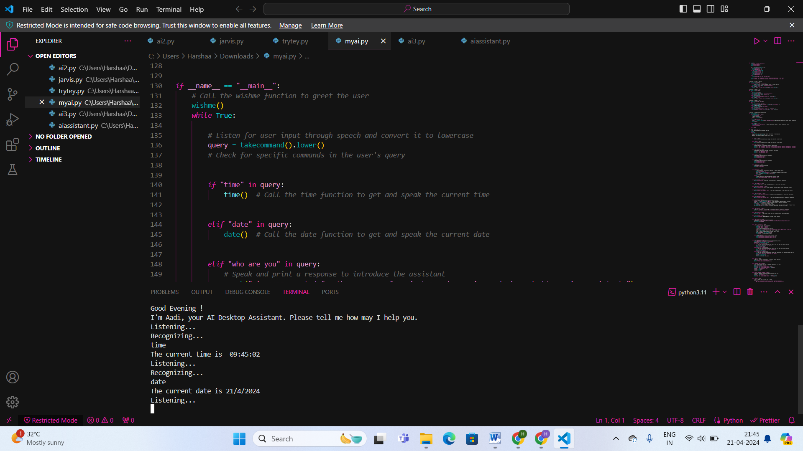
TIME AND DATE REPORTING

Slide 7
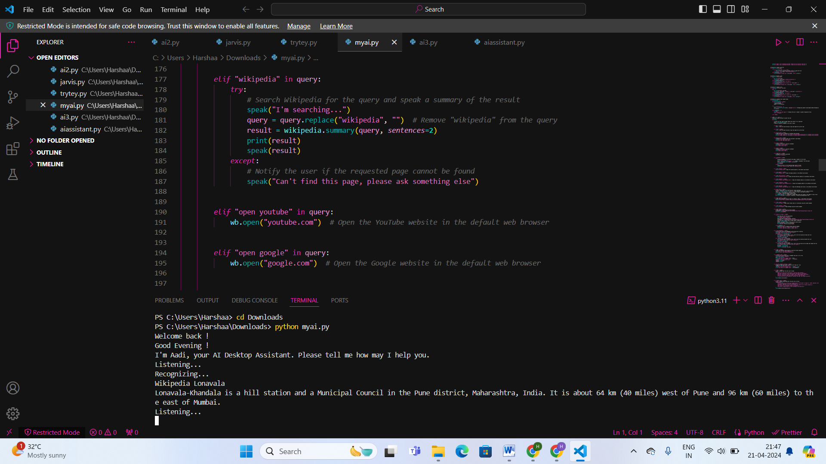
INTERNET BROWSING AND SEARCH CAPABILITIES

Slide 8
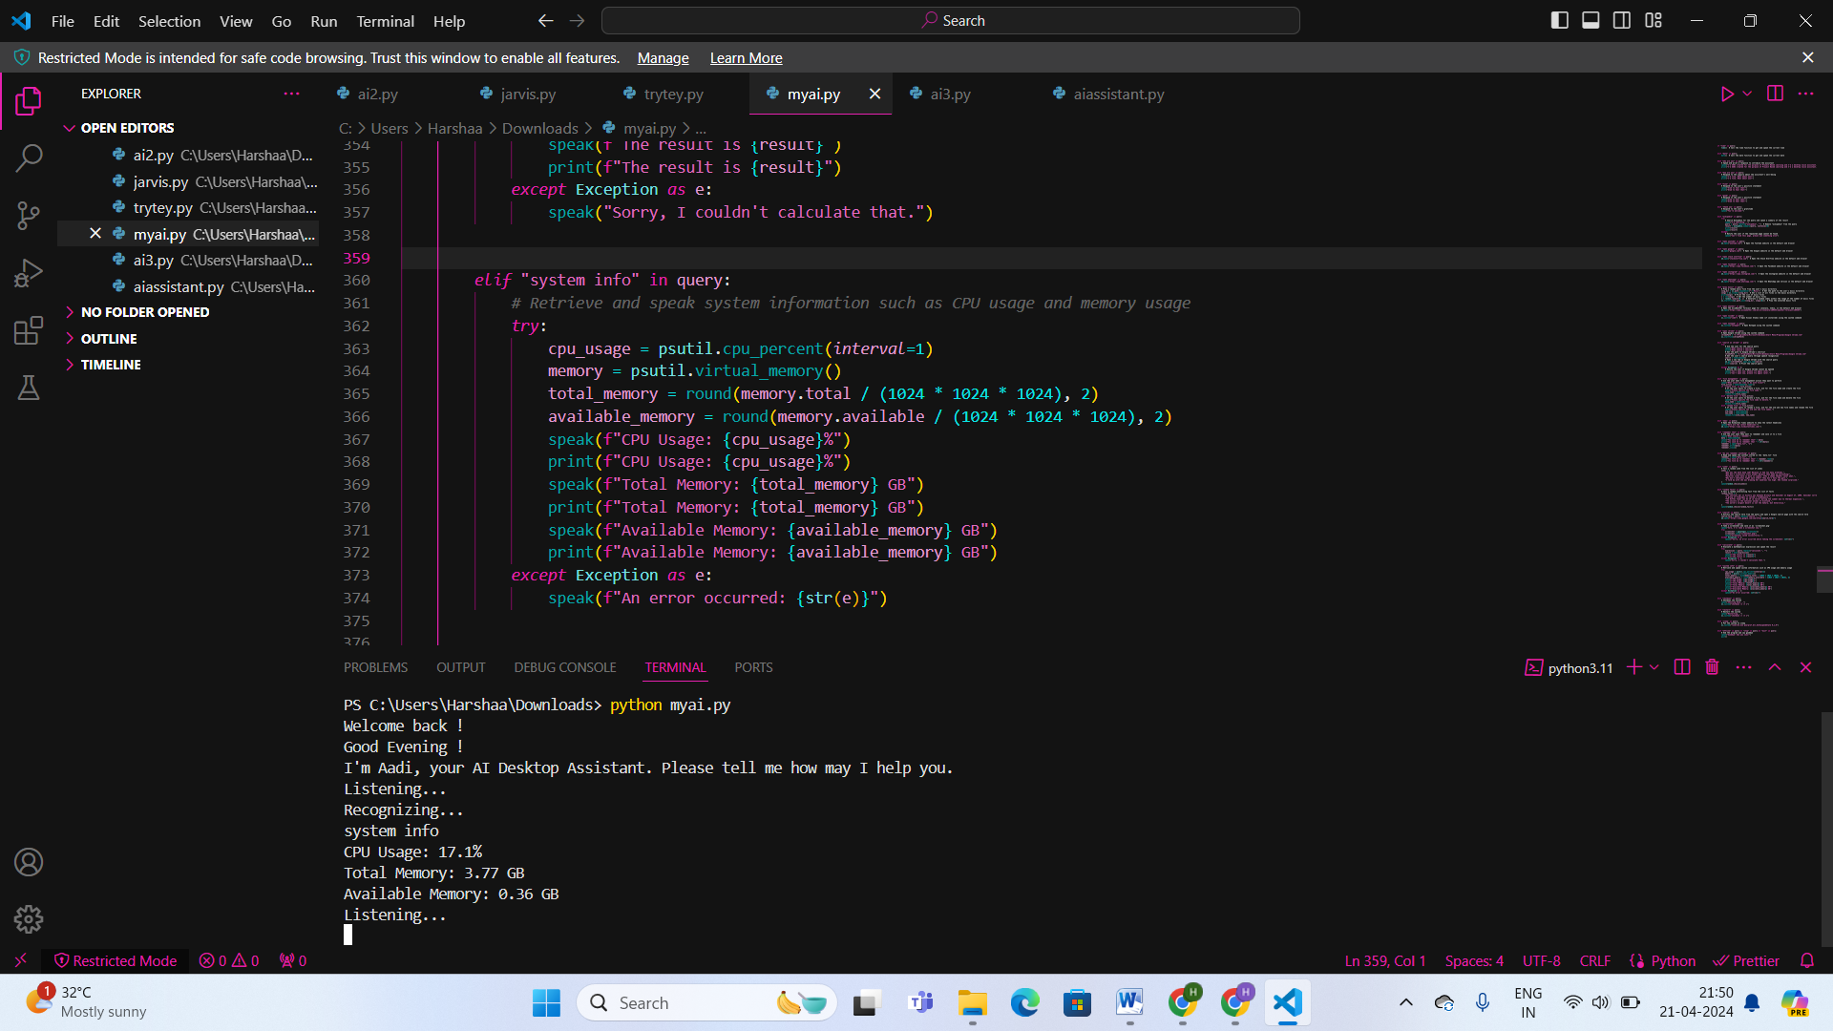
SYSTEM INFORMATION AND MANAGEMENT

Slide 9



FEATURES AND FUNCTIONALITY
ENTERTAINMENT FEATURES
USER INPUT RETENTION
FILE MANAGEMENT
AADI provides entertainment features such as jokes and music playback to enhance user experience.
Users can ask AADI to tell jokes or play music from their local library, providing moments of relaxation and enjoyment.
AADI assists users in managing files and directories on their desktop systems.
Users can ask AADI to create, delete, or rename files, streamlining file management tasks.
.Users can rely on AADI to remember previous interactions and tailor responses accordingly, creating a more personalized and seamless interaction.

Slide 10
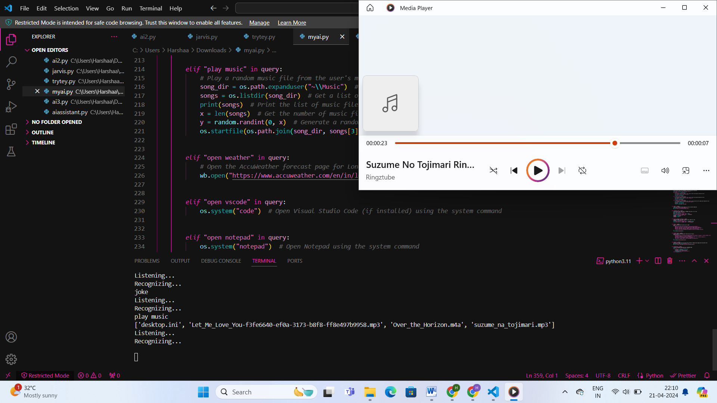
ENTERTAINMENT FEATURES

Slide 11
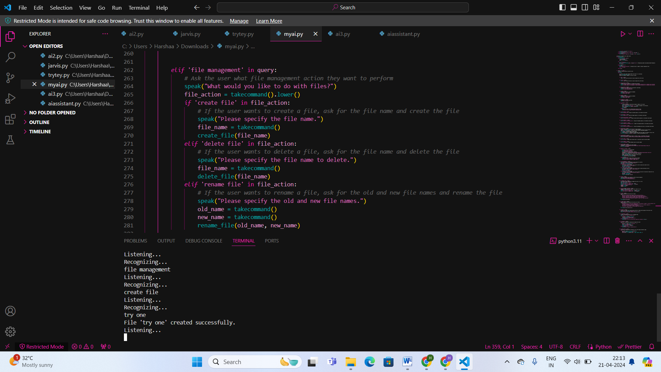
FILE MANAGEMENT

Slide 12

FILE MANAGEMENT

Slide 13
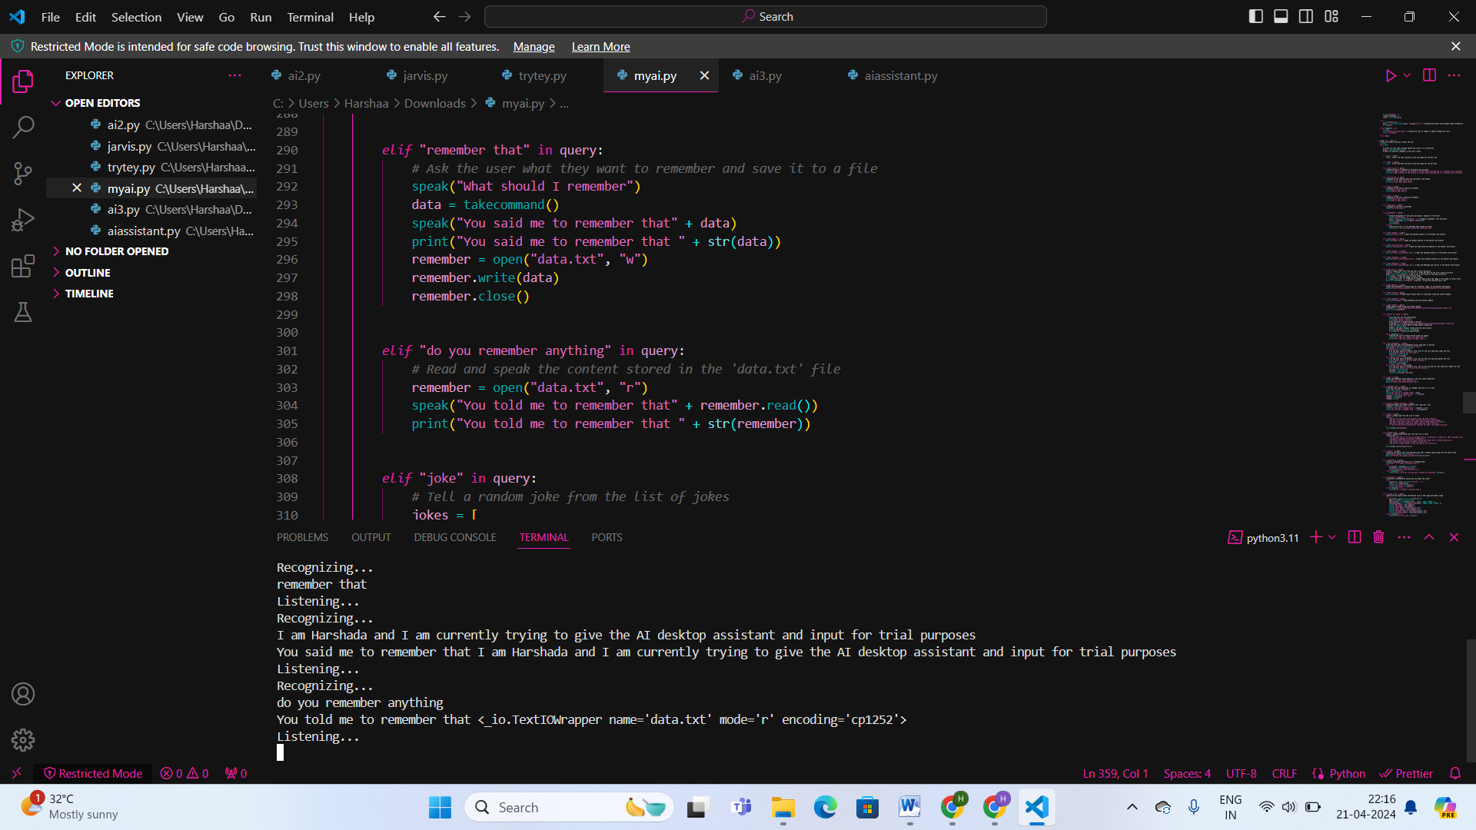
USER INPUT RETENTION

Slide 14
IMPLEMENTATION
Technology Stack
The technology stack includes:
Python: AADI's core programming language for its flexibility, ease of use, and rich ecosystem of libraries.
SpeechRecognition Library: Used for implementing speech recognition functionality, allowing AADI to understand user commands.
Pyttsx3 Library: Utilized for text-to-speech conversion, enabling AADI to respond to user queries vocally.
Psutil Library: Integrated for system monitoring and management, providing insights into system resources.
Wikipedia Library: Incorporated for accessing Wikipedia articles, enriching AADI's knowledge base.
Webbrowser Library: Employed for web browsing functionality, facilitating internet searches and webpage navigation.
Pyautogui Library: Utilized for GUI automation, enabling AADI to interact with the desktop environment.

Slide 15
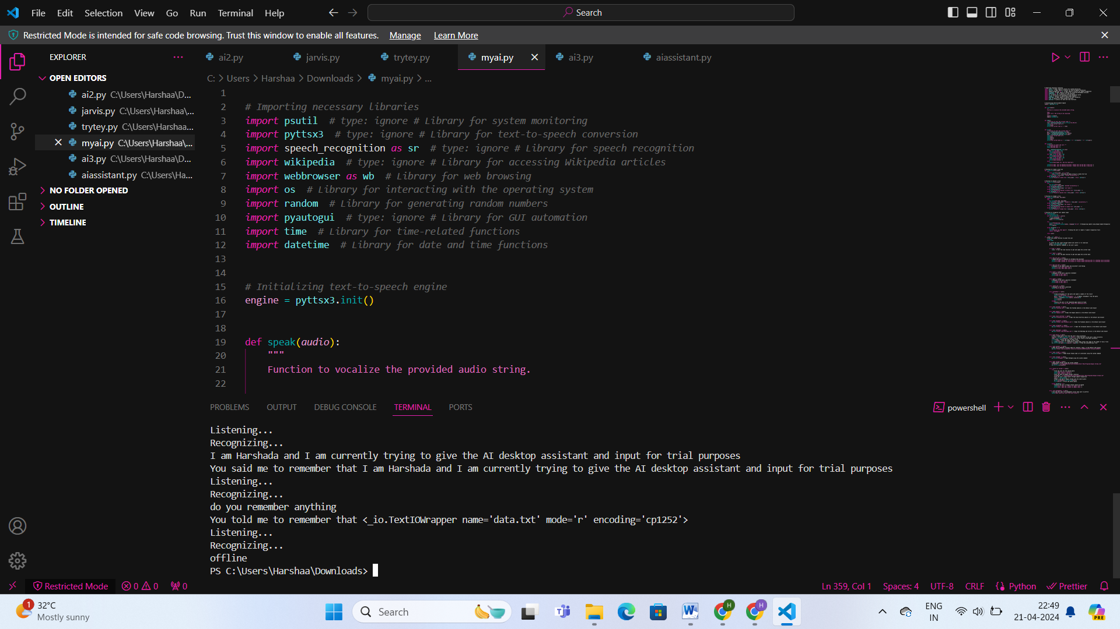
Technology Stack

Slide 16


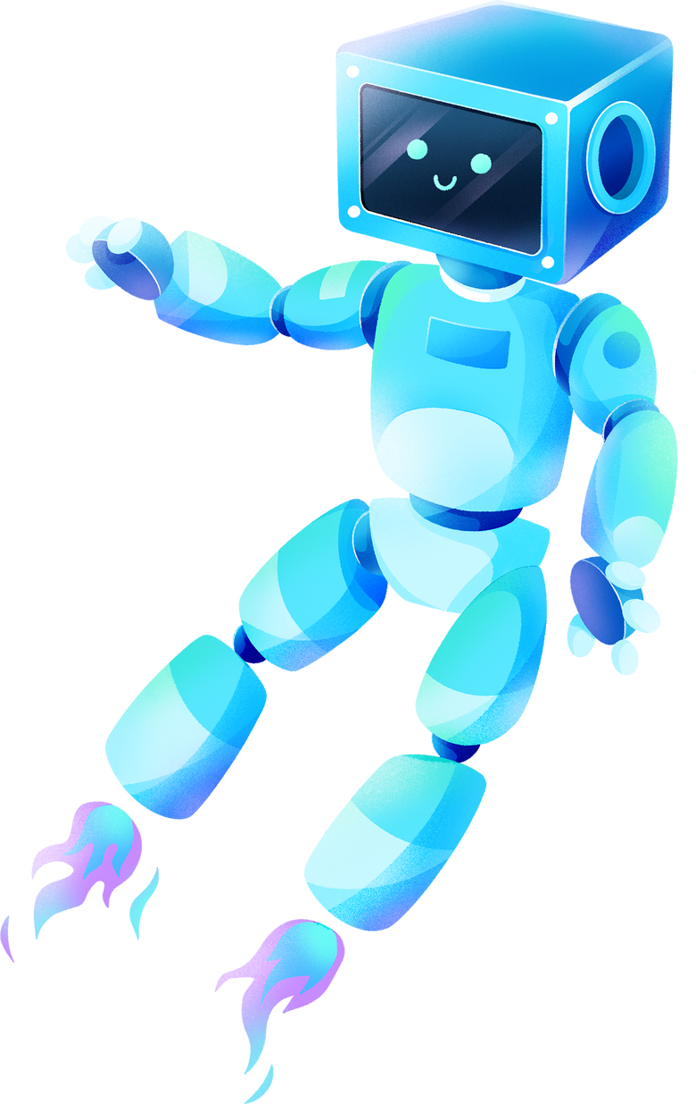



IMPLEMENTATION OF KEY FEATURES
SPEECH RECOGNITION
Implemented using the SpeechRecognition library, which allows AADI to transcribe spoken commands into text for processing.
TEXT TO SPEECH CONVERSION
Achieved using the Pyttsx3 library, enabling AADI to vocalize responses to user queries.
API INTEGRATION
AADI integrates with external APIs such as Wikipedia and web browsers to fetch information and perform tasks requested by users.

Slide 17

TESTING AND VALIDATION
01
02
03
04
Unit Testing:
Testing individual components and functions of AADI to verify their correctness and behavior.
Integration Testing:
Testing the integration between different modules and components of AADI to ensure seamless functionality.
User Acceptance Testing (UAT):
Involving real users to validate AADI's usability, effectiveness, and user satisfaction.
Regression Testing: Re-running previously executed test cases to ensure that new changes or updates do not adversely affect existing functionality.

Slide 18




CHALLANGES FACED AND SOLUTIONS
Speech Recognition Accuracy: One challenge faced during implementation was ensuring accurate speech recognition, especially in noisy environments. This was addressed by fine-tuning the speech recognition models and implementing noise cancellation techniques.
01
API Integration Complexity: Integrating with external APIs posed challenges due to differences in API specifications and authentication methods. These challenges were overcome through thorough API documentation review and implementation of robust error handling mechanisms.
02

Slide 19
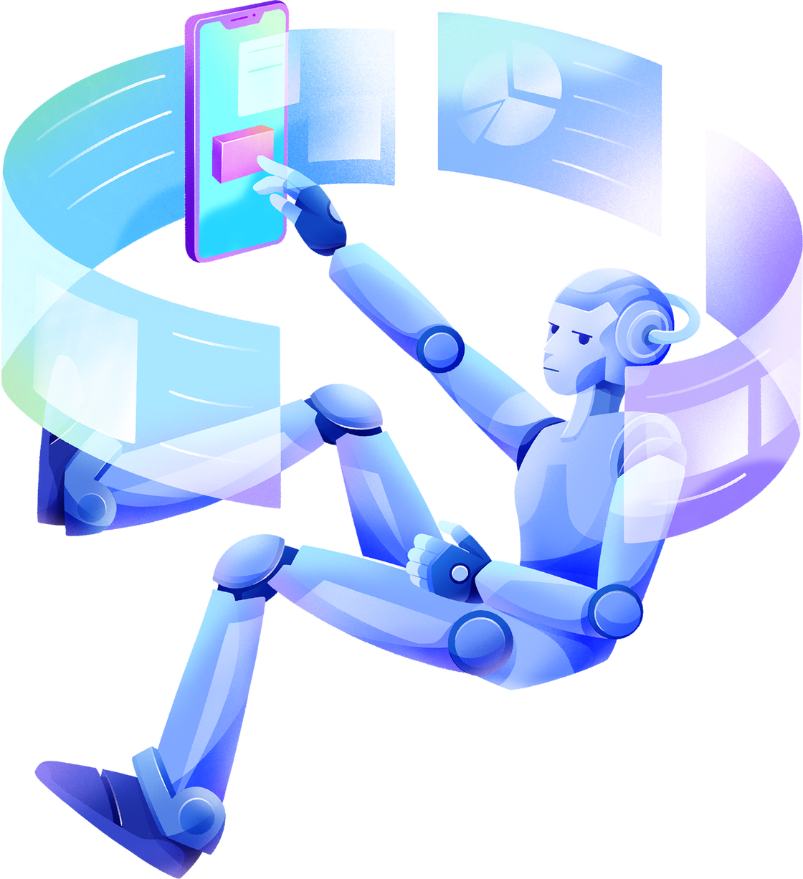

FUTURE ENHANCEMENTS

Slide 20
INTEGRATION WITH ADDITIONAL APIS: AADI CAN BE ENHANCED BY INTEGRATING WITH ADDITIONAL APIS TO EXPAND ITS FUNCTIONALITY AND PROVIDE USERS WITH ACCESS TO A WIDER RANGE OF SERVICES AND INFORMATION. EXAMPLES INCLUDE INTEGRATION WITH WEATHER APIS FOR REAL-TIME WEATHER UPDATES, NEWS APIS FOR LATEST HEADLINES, AND PRODUCTIVITY APIS FOR TASK MANAGEMENT.
IMPROVEMENTS TO EXISTING FEATURES: BASED ON USER FEEDBACK AND USAGE PATTERNS, AADI CAN UNDERGO CONTINUOUS IMPROVEMENTS TO ENHANCE USABILITY AND EFFECTIVENESS. FOR EXAMPLE, REFINING SPEECH RECOGNITION ALGORITHMS TO IMPROVE ACCURACY, OPTIMIZING SYSTEM MANAGEMENT FUNCTIONALITIES FOR BETTER PERFORMANCE, AND ENHANCING ENTERTAINMENT FEATURES WITH MORE DIVERSE CONTENT.
ADOPTION OF ADVANCED AI TECHNIQUES: AADI CAN LEVERAGE ADVANCED AI TECHNIQUES SUCH AS NATURAL LANGUAGE UNDERSTANDING (NLU) AND MACHINE LEARNING (ML) TO ENABLE MORE INTELLIGENT INTERACTIONS AND PERSONALIZED ASSISTANCE. BY UNDERSTANDING USER INTENT AND CONTEXT MORE ACCURATELY, AADI CAN PROVIDE MORE RELEVANT AND TAILORED RESPONSES, IMPROVING USER SATISFACTION AND ENGAGEMENT.
EXPANSION OF SUPPORTED PLATFORMS: AADI CAN BE EXPANDED TO SUPPORT MULTIPLE PLATFORMS BEYOND DESKTOP ENVIRONMENTS, SUCH AS MOBILE DEVICES, SMART HOME ASSISTANTS, AND IOT DEVICES. THIS EXPANSION WOULD ENABLE USERS TO ACCESS AADI'S ASSISTANCE ACROSS VARIOUS DEVICES AND ENVIRONMENTS, ENHANCING ITS VERSATILITY AND UTILITY.
ENHANCED SECURITY AND PRIVACY FEATURES: IMPLEMENTING ROBUST SECURITY AND PRIVACY FEATURES TO SAFEGUARD USER DATA AND ENSURE CONFIDENTIALITY. THIS INCLUDES ENCRYPTION OF SENSITIVE INFORMATION, USER AUTHENTICATION MECHANISMS, AND COMPLIANCE WITH DATA PROTECTION REGULATIONS.

Slide 21


CONCLUSION
AADI marks a significant milestone in desktop computing, offering intelligent assistance and streamlined interactions.
Core functionalities such as speech recognition, internet browsing, and system management enhance user productivity and convenience.
Leveraging AI techniques, AADI makes desktop computing more intuitive and user-friendly.
Gratitude to team members, mentors, and supporters for their dedication and contributions.
AADI's impact extends beyond a desktop assistant, shaping the future of computing.

Slide 22
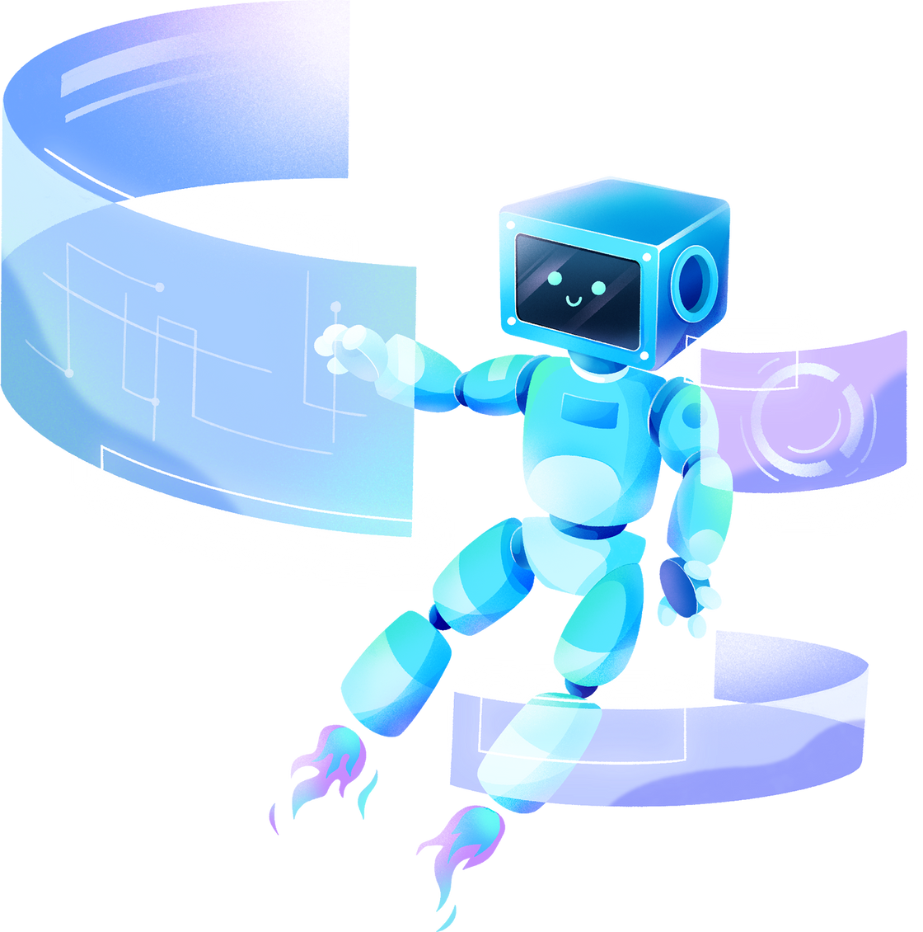
THANK YOU!

